Slide 1
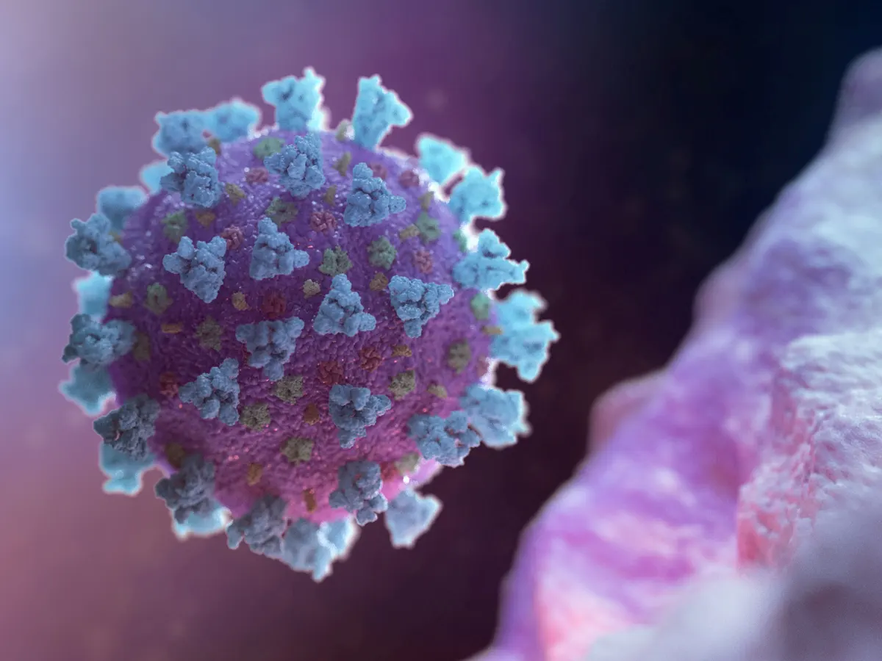
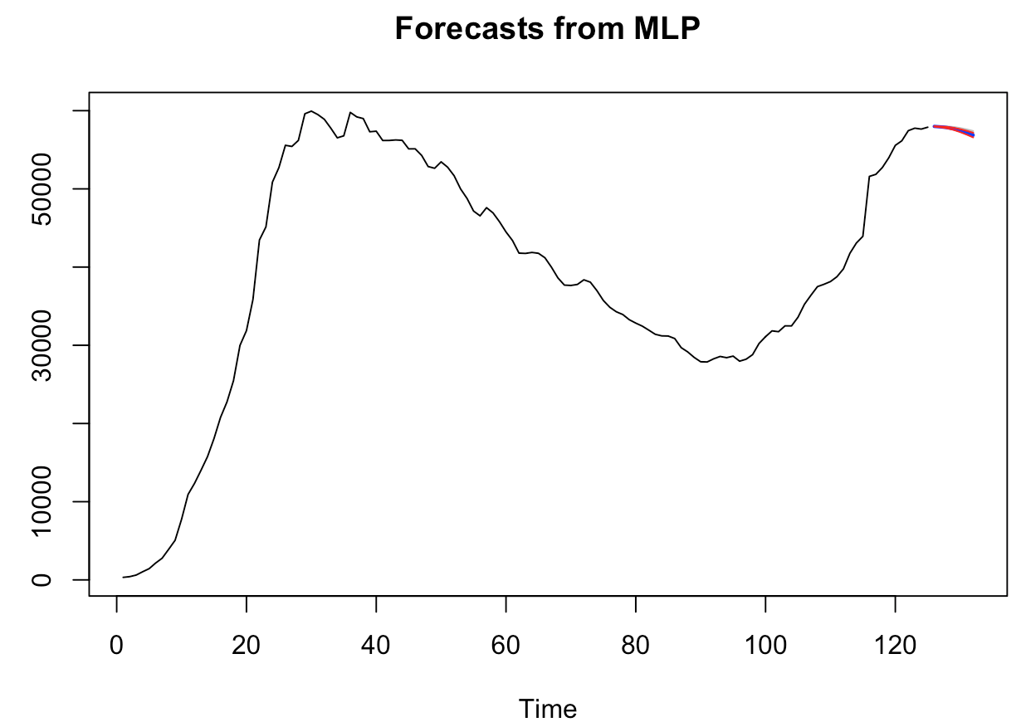
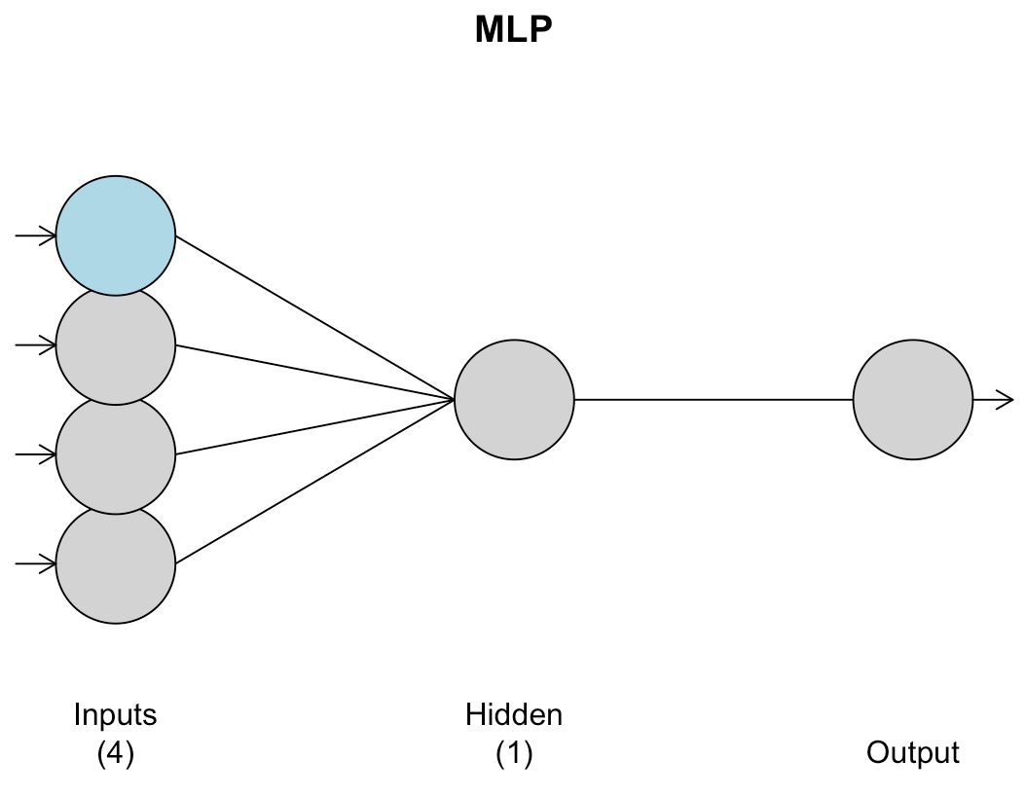
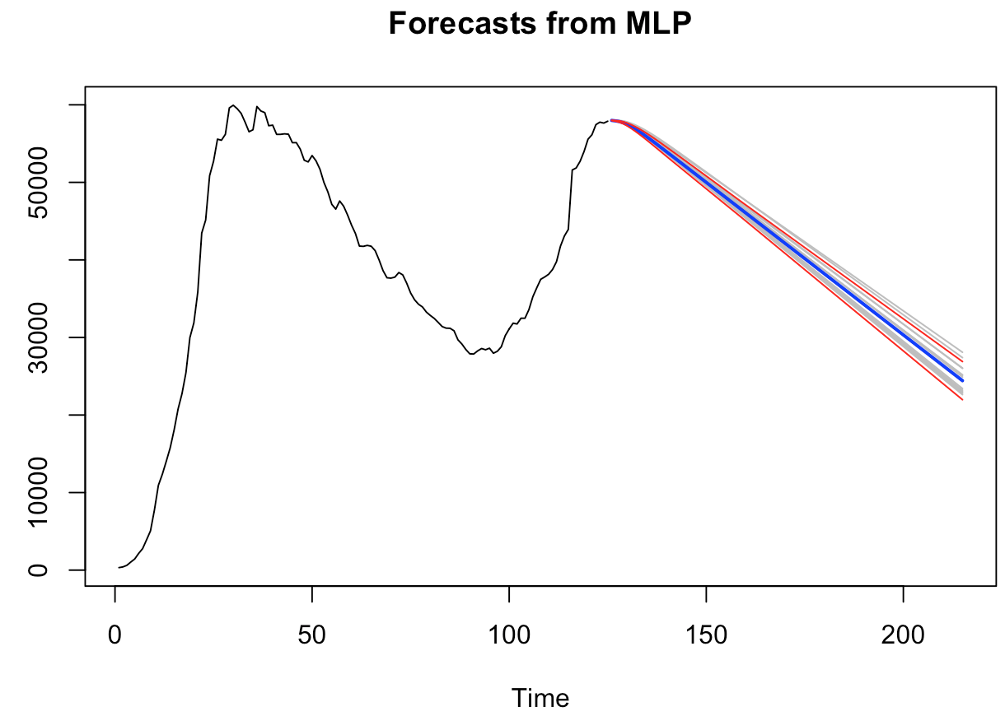

Us Univariate MLP MOdel analysis
Hyper tuned parameters neural network model
Windowed ASE: 8,697,552
Notes:
Jaclyn
Time: 40 seconds
We completed 2 types of multilayer perceptron models for the univariate COVID hospitalization analysis. One with default settings and one with hyper tuned parameters. Default parameters are not the best for modeling data, so we favor the hyper tuned parameter mlp model. We have an ability to perform an origin resampling and obtain a windowed ASE for the hyper tuned parameter mlp model. We decided to leverage the hyper tuned parameter model for our final forecasting univariate methodology we see downward trend for both the 7 and 90-day forecasts.

